Slide 1

Portfolio project – Module 8 - Option #1: Capstone Project – Final Report and Slide Presentation: U.S. Organization Chad Boyle MIS581 capstone – business intelligence and data analytics CSU Global Dr. jamia mills 11/3/2019

Slide 2
Capstone project slide presentation
Section 1: About the Project
Section 2: Descriptive Analysis with Data Visualization
Section 3: Correlation Analysis and Predictive Analytics

Slide 3


About the project - background
Final, capstone assignment for MS – Data Analytics
Independent analytics project
Non-curated data
Speech-giving/presenting/oral communication skills
Example for potential employers
SOURCE: Google Images.
Notes:
The entire premise of this project is very simple – it is meant to recruit from all the different fountains of knowledge that we’ve been drinking from over the course of this program. We’re talking about basic research skills, critical thinking skills, analytical capabilities, proficiency with different tools and techniques, evaluating datasets, understanding outputs, and much, much more. This project is the first that we’ve created (and executed) on our own, with from start to finish, without any real guidance. Not that help wasn’t available along the way; rather, we weren’t constrained by certain requirements or expectations, like with most assignments.
Furthermore, the data for this project was not curated by our professor. Not really, anyway. Normally, when we’ve been tasked to do something with data, we’re provided with the dataset – it’s probably the same dataset that many classes have used before us. In this case, part of the challenge was going out onto the deep, vast Internet, and finding our own dataset that would be suitable for analysis.
Moreover, the fact that this video exists in the first place serves as evidence that this project is about the total package. It’s one thing to be able to do math, or perform statistical analyses, but those efforts have little to no value if you can’t translate those insights into knowledge that people can use, and then communicate that knowledge to those people. Modern data science is about more than just the analytical side of the spectrum – well-honed communication skills are also imperative.
Finally, we made these videos to serve as examples to future and potential employers. Trust me – I can do even more than what I can possibly demonstrate in a ten-minute slideshow!

Slide 4

About the project – the data
Global Superstore 2018
Training data set for practicing with Tableau
24 variables (columns)
51,290 observations (rows)
Over 1.2 million individual data points
SOURCE: Google Images.
Notes:
The dataset that I chose for my analysis is called Global Superstore 2018 and it’s an XLSX Excel file (Brennan, 2019) – no metadata was included in the XLSX file. I discovered it on a community forum for Tableau, a data visualization application, and from what I can tell, the dataset is included for practice purposes with some versions of Tableau. The dataset is 24x51290, so it features 24 variables (columns) with 51,290 observations (rows). For all intents and purposes, it’s a relatively simple, clean, and generic sales-related dataset. The dataset includes regional information, product information, sales information, and shipping information, primarily. The Postal_Code variable doesn’t contain any values for countries outside of the United States, it would seem – every non-U.S. row contains a period, with no other values. Other than that, every variable appears to be correctly formatted, and with no missing values.
When you think about it, this dataset contains over 1.2 million individual data points!

Slide 5
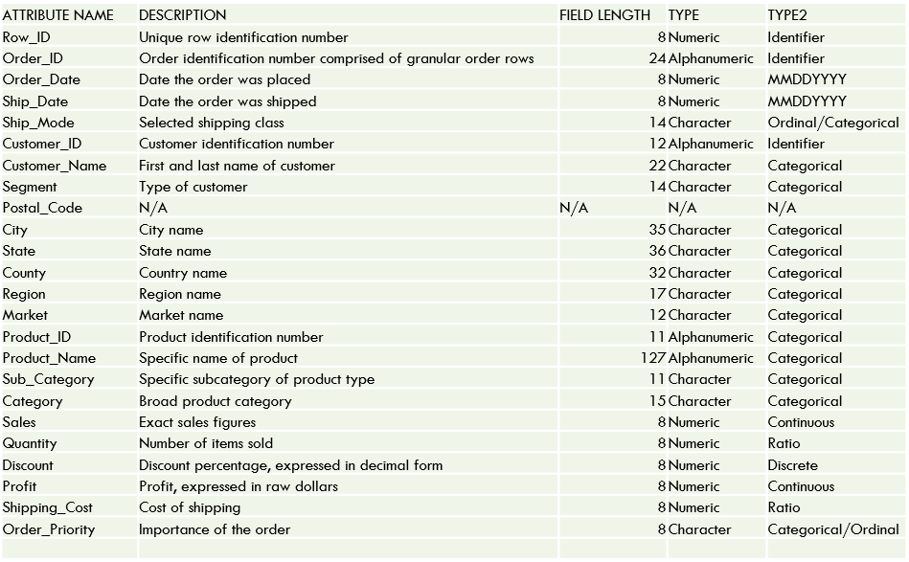
About the project – data dictionary
Provides a brief and concise summary of the data
Nice reference point when you first start working with the data
Serves as a form of metadata for interested parties to follow
SOURCE: Screenshot by C. Boyle, 2019.
Notes:
This is my attempt at a “data dictionary”, of sorts – a visual representation of the characteristics of the data in the dataset. In the dictionary, I included 5 different fields (NNLM, 2019):
Attribute Name – The name of the variable.
Description – A best-guess description of the variable, after looking at the data.
Field Length – The maximum number of characters possible for a variable field.
Type – The type of character permitted in the field.
Type 2 – My attempt to classify the type of variable based on what the data is intended to represent.
Data dictionaries are great because, like data visualizations, it is much easier for our primitive human brains to understand pictures. It’s crisp, it’s clean, and it summarizes everything in a compact fashion.
Plus, when you first start working with datasets, it can be nice to have a dictionary that you can peek at; for example, when executing certain procedures in SAS, you need to type in exact variable names. After awhile, the names all become familiar, but a dictionary can be handy in the interim. Furthermore, if anyone stumbles upon the data later, and they want to know what all the variables represent, a data dictionary is a fantastic resource.

Slide 6

About the project – the business
Per the assignment, choose an organization that could potentially benefit from the analytics techniques described herein
I chose Amazon, but any business can benefit
SOURCE: Google Images.
Notes:
Now, one of the elements of this assignment that we’re not going to talk much about is that of….THE BUSINESS. Specifically, we were instructed to choose a business and discuss how different analytic techniques could potentially be of some value to the chosen organization. I chose Amazon. Why, you ask? Well, if I’m being honest, my approach to this assignment was to choose as broad a company as possible, with as broad a data set as possible, so that I have plenty of options with my final analysis. Let’s face it – Amazon sells just about everything. They’ve got their hands in so many different pies that it would be harder to find ways that data isn’t helpful than to find ways that it is – does that make sense? Plus, everyone is familiar with Amazon and, in my personal experience, all of Amazon’s customers love Amazon. I personally use Amazon Prime all the time, and I stream content with Prime Video on an almost-daily basis. I like Amazon, and it’s easier to work with things that you enjoy, right?
Furthermore, it’s 2019 – anyone can benefit from data science in at least some capacity, and there is some capacity of data science available to everyone. It doesn’t matter how small, or large, or complex, or simple, or anything in between, a business may be – anyone can benefit from what we’re going to talk about today.

Slide 7
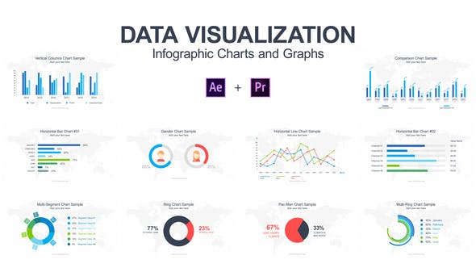
Descriptive analysis with data visualization
It is easier for people to process large amounts of information visually
Many different software solutions
Tableau
Domo
SAS
R
Capable of easily answering many basic (albeit important) and fundamental business questions
SOURCE: Google Images.
Notes:
Sometimes, it can be difficult to make sense of what we’re seeing when we’re trying to take into consideration hundreds (if not thousands, if not tens of thousands) of numeric variables. Consider my chosen dataset, for instance, which contains over 50,000 rows of data – it would take an eternity to draw meaningful conclusions about even the simplest of questions just by looking at the raw data. Imagine the following business questions:
Which customer segment generates the greatest amount of sales?
Which specific products are most popular?
What do sales look like over the past few years for which data exists?
When people put data in a visual form, it can be much easier to process quickly and efficiently, especially if the hard details are not as important.
There is a HUGE variety of data visualization software on the market, such as Tableau, Domo, SAS, R, and about two million others. If you go on Google and search for “most in demand analytics skills” or some other permutation thereof, I’ve no doubt that “data visualization” capabilities are going to show up on many lists.

Slide 8
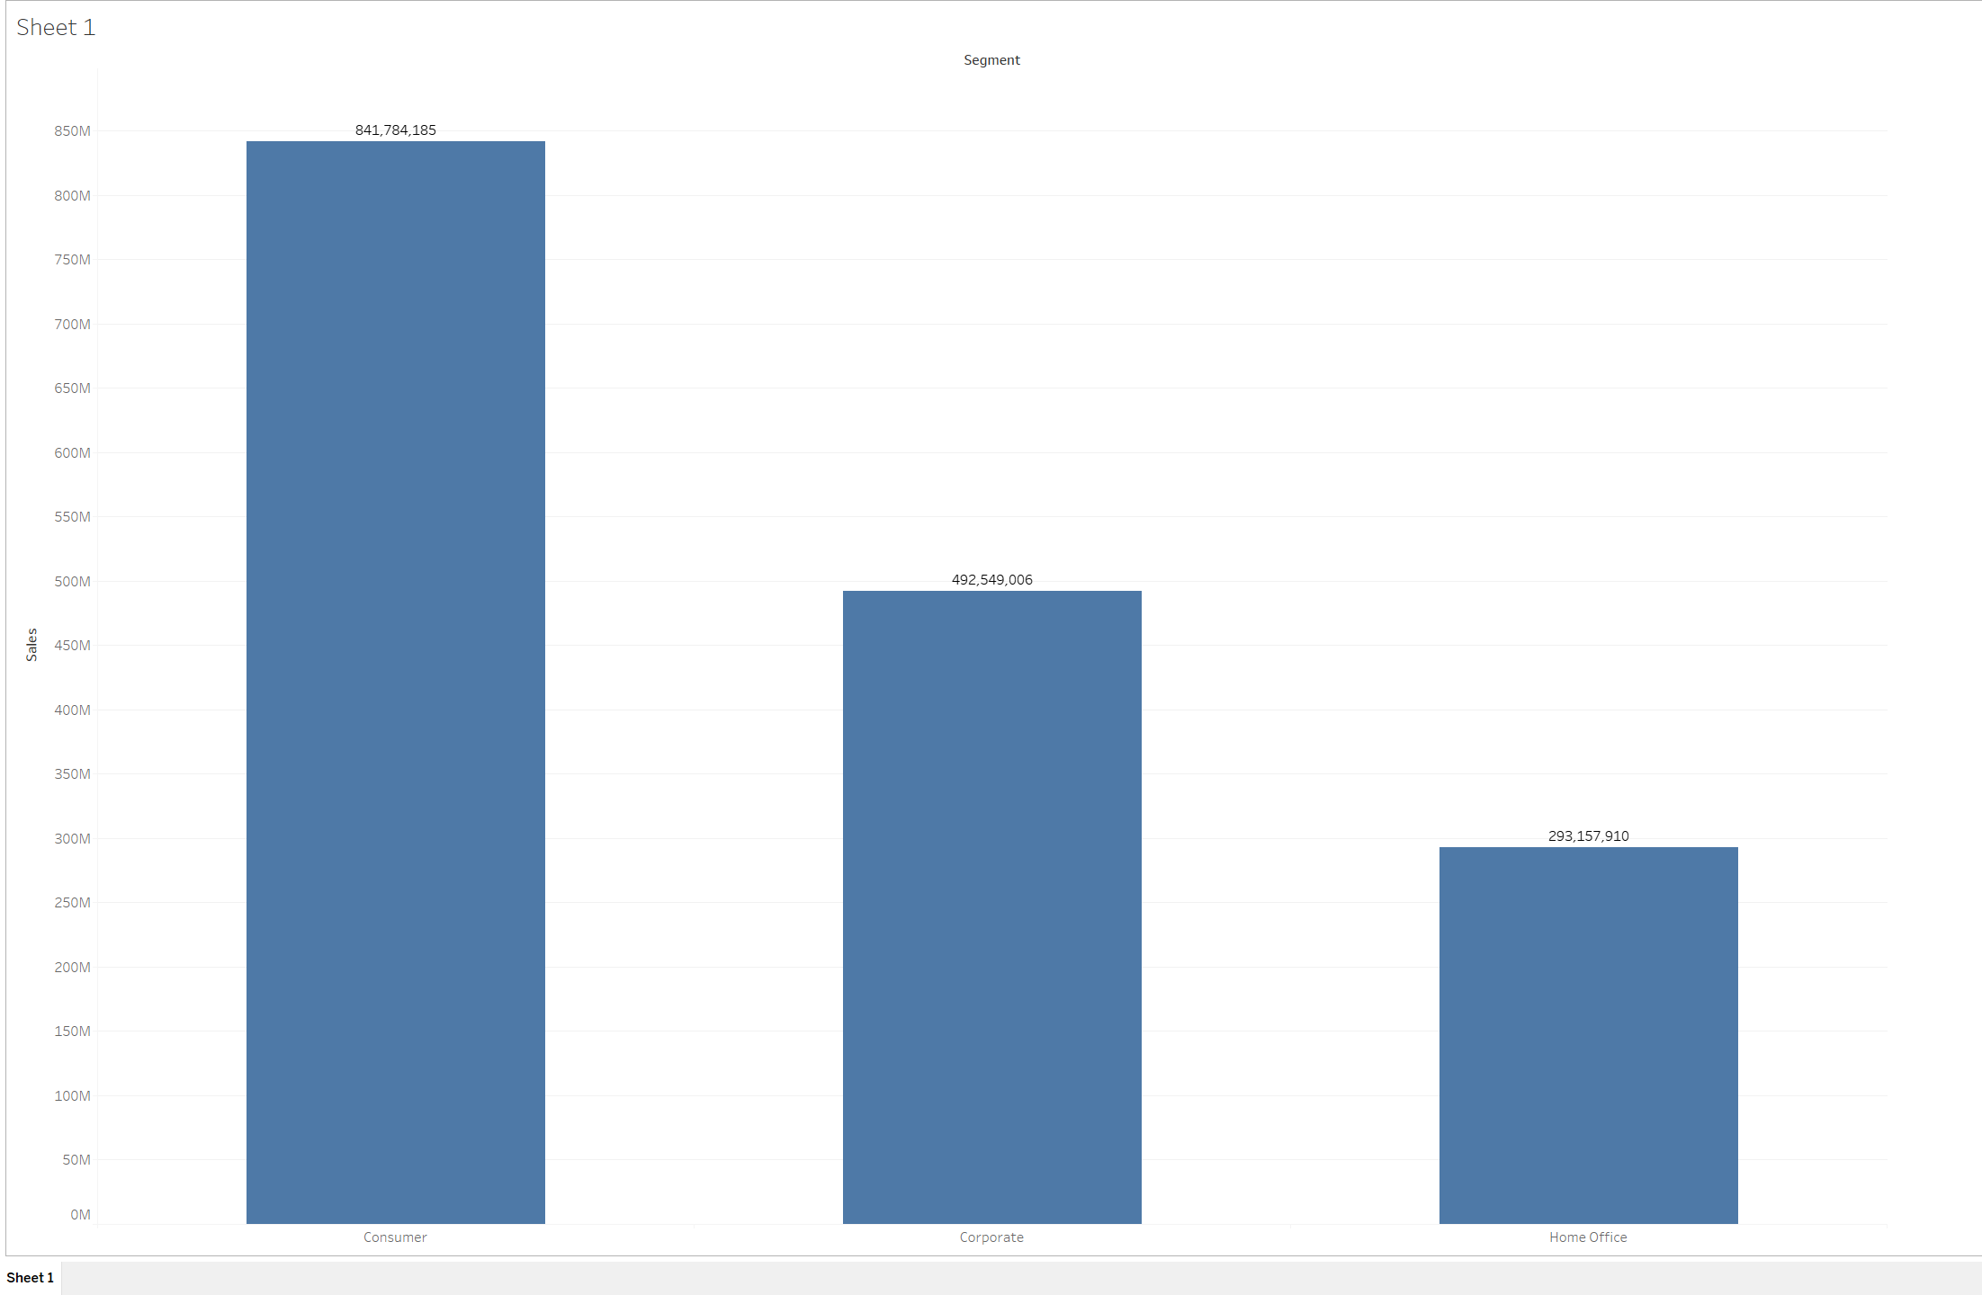
Data visualization – business questions
Where do our sales come from?
Which segment of the business is responsible for the greatest amount of revenue?
How significant is the difference in revenue generation between the segments?
SOURCE: Screenshot by C. Boyle, 2019.
Notes:
Take this first example of data visualization in action. Now, on one hand, I could tell you that, over the past four years, sales have been the following:
841,784,185
492,549,006
293,157,910
Or, I could just show you the graphic. Where do our sales come from? Well, by looking at the visualization, we know that a huge chunk of our sales come from the consumer segment; however, it’s also very easy for us to understand the degree to which one segment outperforms (or underperforms) another. After all, we can see the bars, we can see the numbers, we can see the labels, and so on. Each of these three bars represent calculations involving thousands and thousands and thousands of data points, all summarized in three simple, blue blobs.

Slide 9
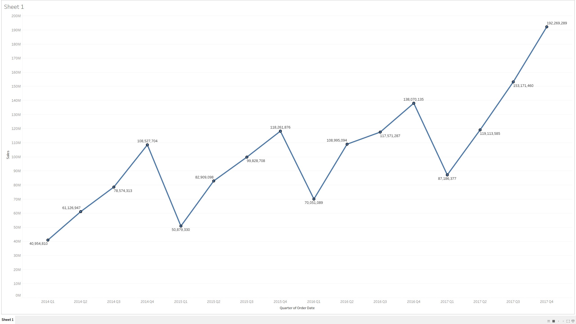
Data visualization – business questions
Time-series of historical data to show revenue trends
Is revenue growing, and, if so, what does that growth look like?
Month over month?
Quarter over quarter?
Obvious Trend
SOURCE: Screenshot by C. Boyle, 2019.
Notes:
Once again, this is a data visualization using the Global Superstore dataset. Here, we’re looking at four years of sales down, broken down by quarters. Clearly, we see a pattern, right? Every year, revenue climbs and climbs, every quarter, until its apex in the fourth quarter, and then falls again. Every quarter generates more revenue than the same quarter from the previous year. This brings up interesting, new questions. Why the consistent pattern? Why are third quarter sales always so much higher than first quarter sales, every single year?

Slide 10
Correlation analysis and predictive analytics – hypothesis testing
A hypothesis is a statement of conjecture about the relationship between two or more variables (Kerlinger, 1957)
A hypothesis is a hunch or guess about the nature of relationships between variables, declared as a testable statement (O’Leary, 2017)
Key Characteristics:
Simple and specific
Explanatory
Testable
Consistent with existing knowledge
Notes:
What is a hypothesis, exactly? Many of us have probably heard the colloquial definition – that a hypothesis is an educated guess. Depending on who you ask, you’ll receive a multitude of answers, but they all look and sound very much alike. According to Kerlinger (1957), a hypothesis is a statement of conjecture about the relationship between two or more variables – a relational proposition. According to O’Leary (2017), a hypothesis is a hunch or guess about the nature of relationships between variables, declared as a testable statement. In other words, a hypothesis is an interim explanation or proposed relationship, derived in part from existing knowledge, that has clear implications for testing and measurement. A good hypothesis should incorporate the following key characteristics (Mourougan & Sethuraman, 2017):
Simple and specific
Explanatory
State the relationship
Testable
Consistent with existing literature
Hypotheses are important for several reasons. For example, hypotheses are testable, relational statements that provide direction to a research project (Mourougan & Sethuraman, 2017). Moreover, hypotheses provide a framework for the reporting of conclusions (Mourougan & Sethuraman, 2017).

Slide 11
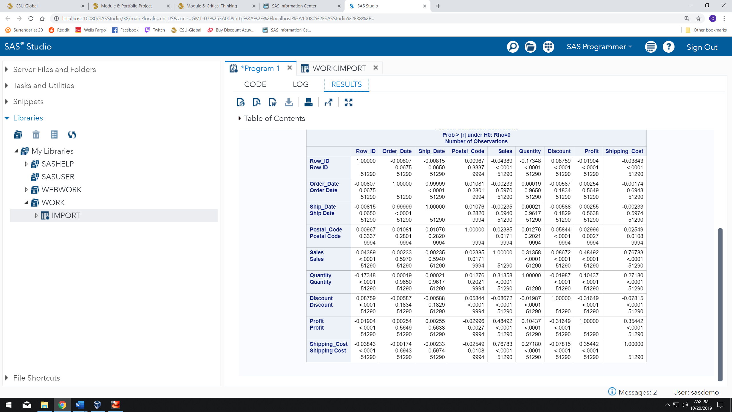
Correlation analysis and predictive analytics
Statistical evaluation that looks at the strength of relationships between variables
Good for establishing connections between variables in a dataset
Test hypotheses using correlation coefficients (r values) and confidence levels (p values)
SOURCE: Screenshot by C. Boyle, 2019.
Notes:
One method of testing a hypothesis is to use correlation analysis, which is a type of statistical evaluation that examines the strength of a relationship between two continuous, numeric variables. Correlation analysis is particularly useful when we want to establish the existence of possible connections between variables in a dataset.
Depending on the type of correlation analysis performed, some sort of correlation coefficient is the ultimate output – a coefficient of 0 represents no correlation, while coefficients of 1 and -1 represent perfect direct and inverse correlations, respectively. Furthermore, most correlation analyses provide statistical significance levels, which, in large part, enables us to determine whether we should reject our null hypothesis or not.
For the purposes of this project, I posed a very broad, simple hypothesis:
H₀ = There are no statistically significant correlations between any of the numeric, continuous variables in the selected dataset.
H₁ = There are statistically significant correlations between numeric, continuous variables in the selected dataset.
In other words, I just wanted to know if there was anything going on. I also hypothesized that there would be some strong relationships with the primary Sales variable but, again, I really wasn’t look for anything specific.

Slide 12
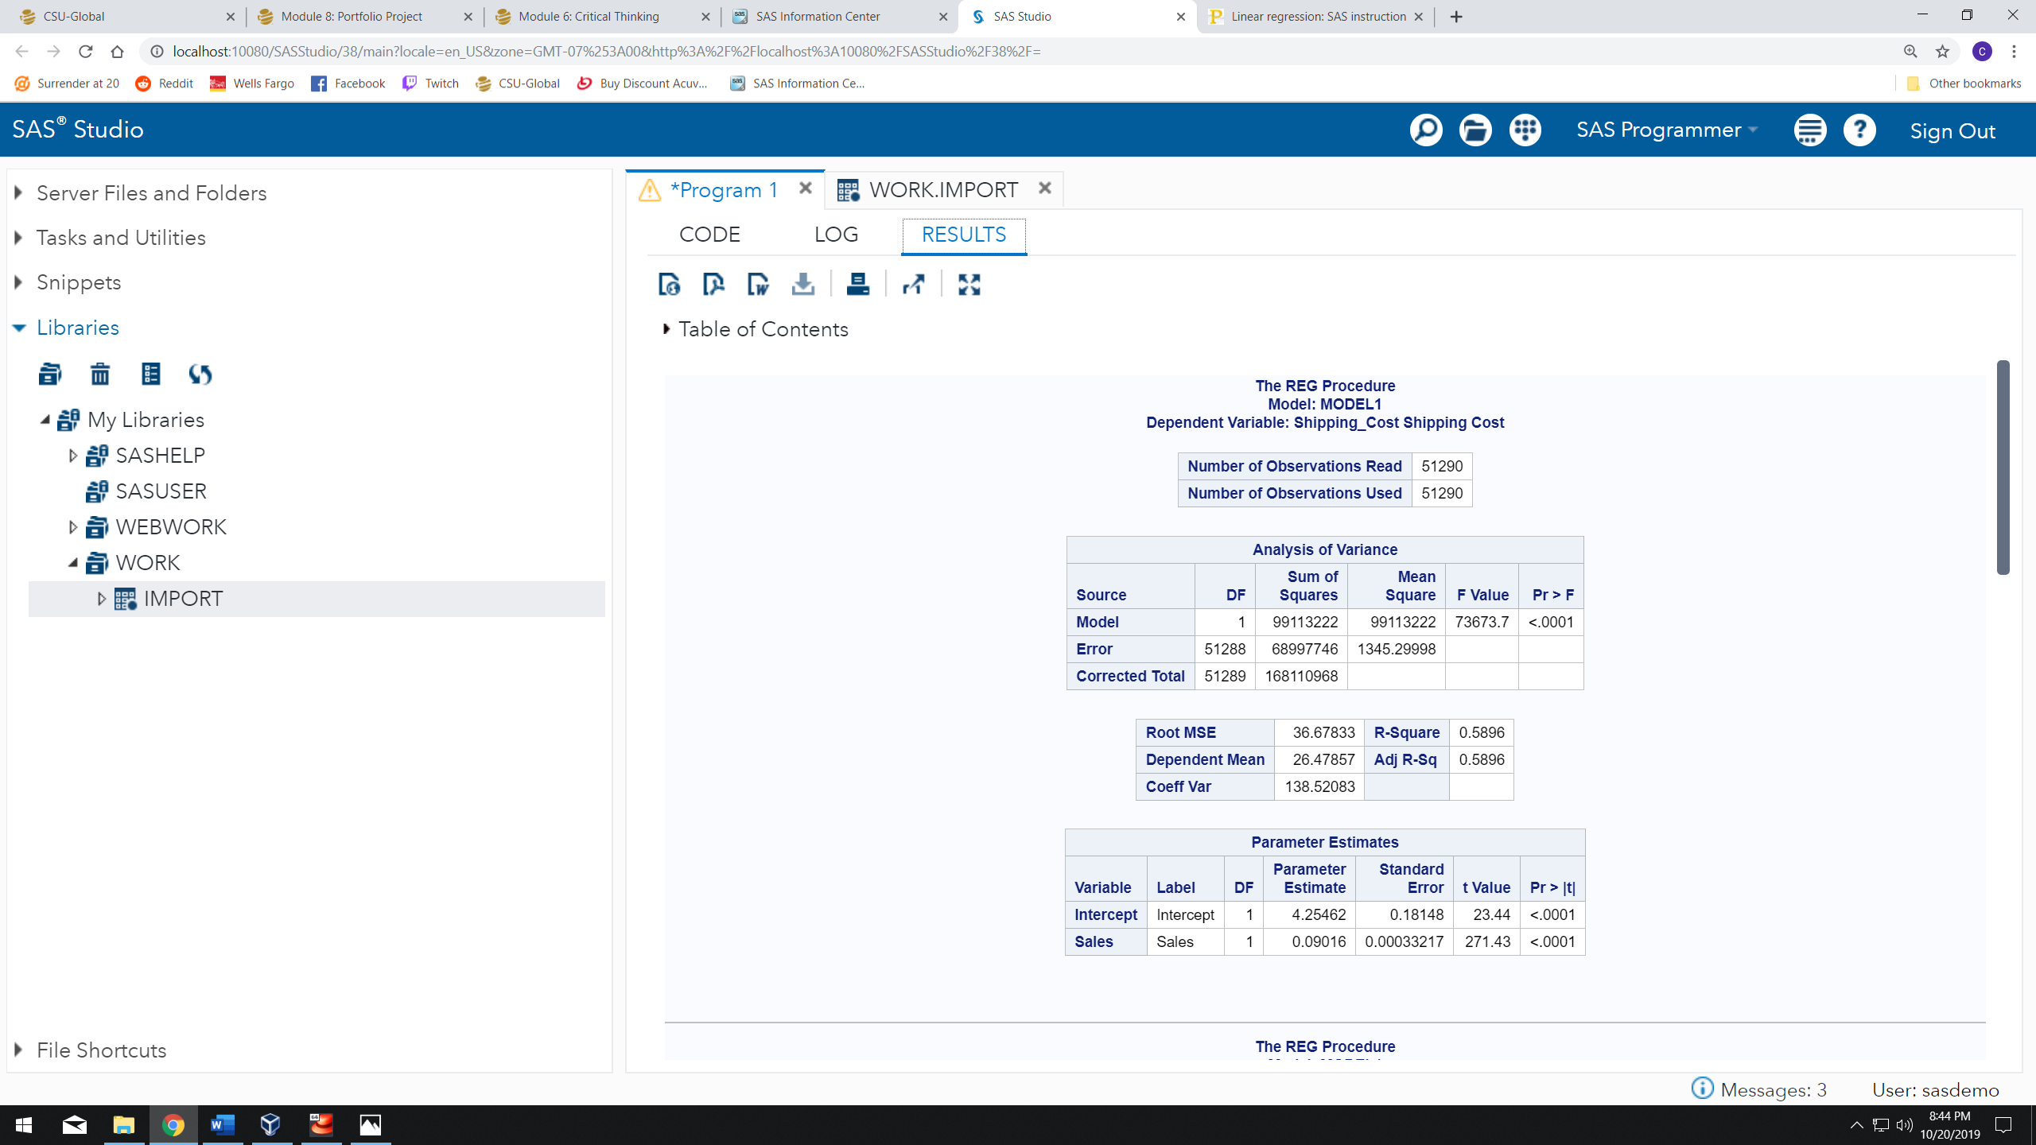
Correlation analysis and predictive analytics
Correlation analysis can be used to identify candidate variables for predictive modeling
High correlation coefficient + high level of confidence
Regression analysis
SOURCE: Screenshot by C. Boyle, 2019.
Notes:
Based on the correlation matrix from the previous slide, I was able to nail down a few relationships with statistically significant correlation coefficients. According to the correlation matrix, there is a strong, direct correlational relationship between Sales and Shipping_Cost; that is, as values of Sales increase, values of Shipping_Cost tend to increase, as well, and to a substantial degree. In fact, for an organization such as Amazon, the ability to make predictions around shipping costs seems like it could be quite beneficial.
Next, I decided to perform a regression analysis using Shipping_Cost as our dependent variable, and Sales as our independent variable. According to the R-Square value (also known as the coefficient of determination), the Sales variable can account for about 59% of the variability in the Shipping_Cost variable.

Slide 13
Correlation analysis and predictive analytics – linear regression
Y = A + BX
Y = dependent variable
X = independent variable
A = intercept
B = slope
Shipping_Cost = 4.255 + .09(Sales)
SOURCE: Screenshot by C. Boyle, 2019.
Notes:
So, how can we use this information to predict values? Regression analysis provides the only two outputs that we need in order to create our predictive equation – the slope, and the intercept.
Once I have those two magical numbers, I can plug them into the following formula:
Y = A + BX
In this formula, Y is our dependent variable (Shipping_Cost), which is the variable we want to predict, while X is our independent variable, the value of which is known to us – A represents the y-intercept of the regression line, while B represents the slope of that same line (both the slope and the intercept are provided in the “Parameter Estimates” section of the procedure results. If we plug in all the corresponding values, we end up with the following formula:
Shipping_Cost = 4.255 + .09 (Sales)
Let’s assume that a cart has $100 dollars-worth of items in it – how much is shipping going to cost? According to our formula:
Shipping_Cost = 4.255 + .09 (100)
Shipping_Cost = 4.255 + 9
Shipping_Cost = ~$13.25
Apparently, according to the data, it would cost roughly $13.25, on average, to ship $100 worth of items.

Slide 14
References
Brennan, C. (2019, January 30). Tableau Community Forums. Retrieved from https://community.tableau.com/message/865707#865707
Chapple, M. (2018). Data Privacy. Retrieved October 4, 2019, from https://www.linkedin.com/learning/sscp-cert-prep-2-security-operations-and-administration/data-privacy?u=2245842&auth=true.
Condon, S. (2019, January 31). In 2018, AWS delivered most of Amazon's operating income. Retrieved from https://www.zdnet.com/article/in-2018-aws-delivered-most-of-amazons-operating-income/
Davis, K., & Patterson, D. (2012). Ethics of big data. Farnham: OReilly.
Desjardins, J. (2017, December 19). Breaking Down How Amazon Makes Money. Retrieved from https://www.visualcapitalist.com/breaking-amazon-makes-money/
Elliott, A. C., & Woodward, W. A. (2016). Sas essentials: mastering Sas for data analytics. Hoboken, NJ: John Wiley and Sons, Inc.
Field, A. (2013). Discovering statistics using Ibm Spss statistics: (and sex and drugs and rock n roll) / Andy Field. London: Sage.
Kaur, M., & Kang, S. (2016). Market Basket Analysis: Identify the Changing Trends of Market Data Using Association Rule Mining. Procedia Computer Science, 85, 78–85. doi: 10.1016/j.procs.2016.05.180
Kerlinger, F. N. (1957). Research design and analysis of variance; a manual for students of education. New York: School of Education, New York University.
Macrotrends. (2019). Amazon Revenue 2006-2019: AMZN. Retrieved from https://www.macrotrends.net/stocks/charts/AMZN/amazon/revenue
Meirelles, I. (2013). Design for information: an introduction to the histories, theories, and best practices behind effective information visualizations. Beverly: Rockport.
Mourougan, S., & Sethuraman, K. (2017, May). Hypothesis Development and Testing. Retrieved September 29, 2019, from https://pdfs.semanticscholar.org/9bd0/d555e809ac52142271fd04489e7d5e97e2ec.pdf.
NNLM. (2019). Data Dictionary. Retrieved from https://nnlm.gov/data/thesaurus/data-dictionary
O’Leary, Z. (2017). The essential guide to doing your research project. London: SAGE.
Richter, F. (2018, November 1). Infographic: Amazon's Workforce Is More Than Half a Million Strong. Retrieved from https://www.statista.com/chart/7581/amazons-global-workforce/

